Slide 1
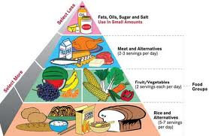
FOOD PYRAMID
A food guide pyramid is a pyramid shaped guide of healthy foods divided into sections to show the recommended intake for each food group.There are five basic nutrients.

Slide 2
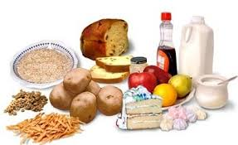
Five basic nutrients
1.carbohydrates: Carbohydrates can be grouped into two categories: simple and complex. Simple carbohydrates are sugars whereas complex carbohydrates consist of starch and dietary fibre.eg:

Slide 3
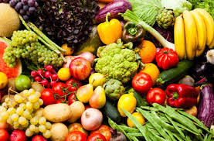
Basic nutrients
Vitamins and minerals
Vitamins help to regulate chemical reactions in the body. There are 13 vitamins, including vitamins A, B complex, C, D, E, and K. Because most vitamins cannot be made in the body, we must obtain them through the diet.
Minerals
Minerals are components of foods that are involved in many body functions. For example, calcium and magnesium are important for bone structure, and iron is needed for our red blood cells to transport oxygen

Slide 4
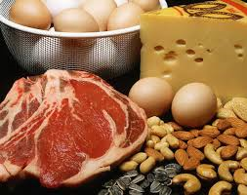
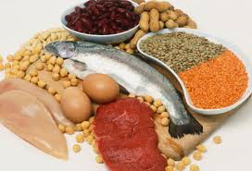
Basic nutrients
Protiens
Main sources of protein are animal products like meat, fish, poultry, milk, cheese and eggs and vegetable sources like legumes (beans, lentils, dried peas, nuts) and seeds.
Protein from food is broken down into amino acids by the digestive system. These amino acids are then used for building and repairing muscles, red blood cells, hair and other tissues, and for making hormones.

Slide 5
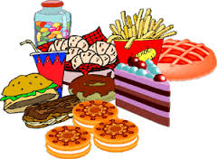
Basic nutrients
Fats
Fat maintains skin and hair, cushions vital organs, provides insulation, and is necessary for the production and absorption of certain vitamins and hormones.

