Slide 1
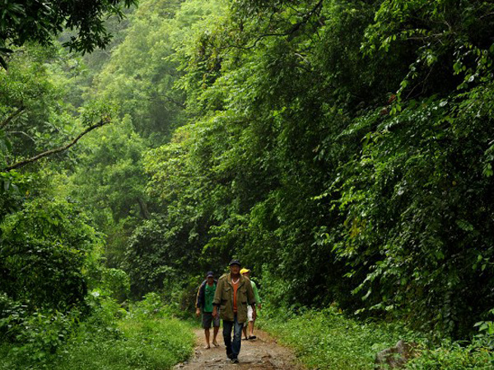
DEFORESTATION
FOREST
A walk in the rain forest
By Keya Menezes

Slide 2
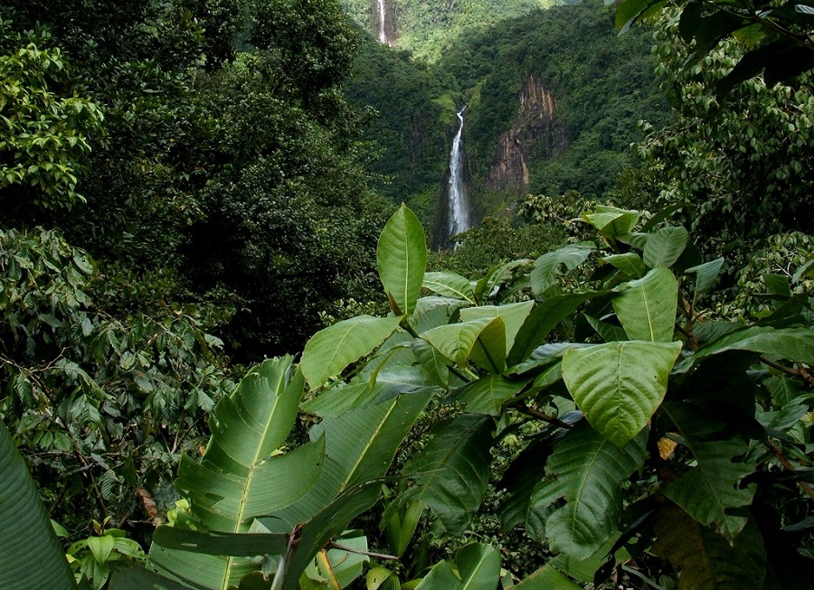
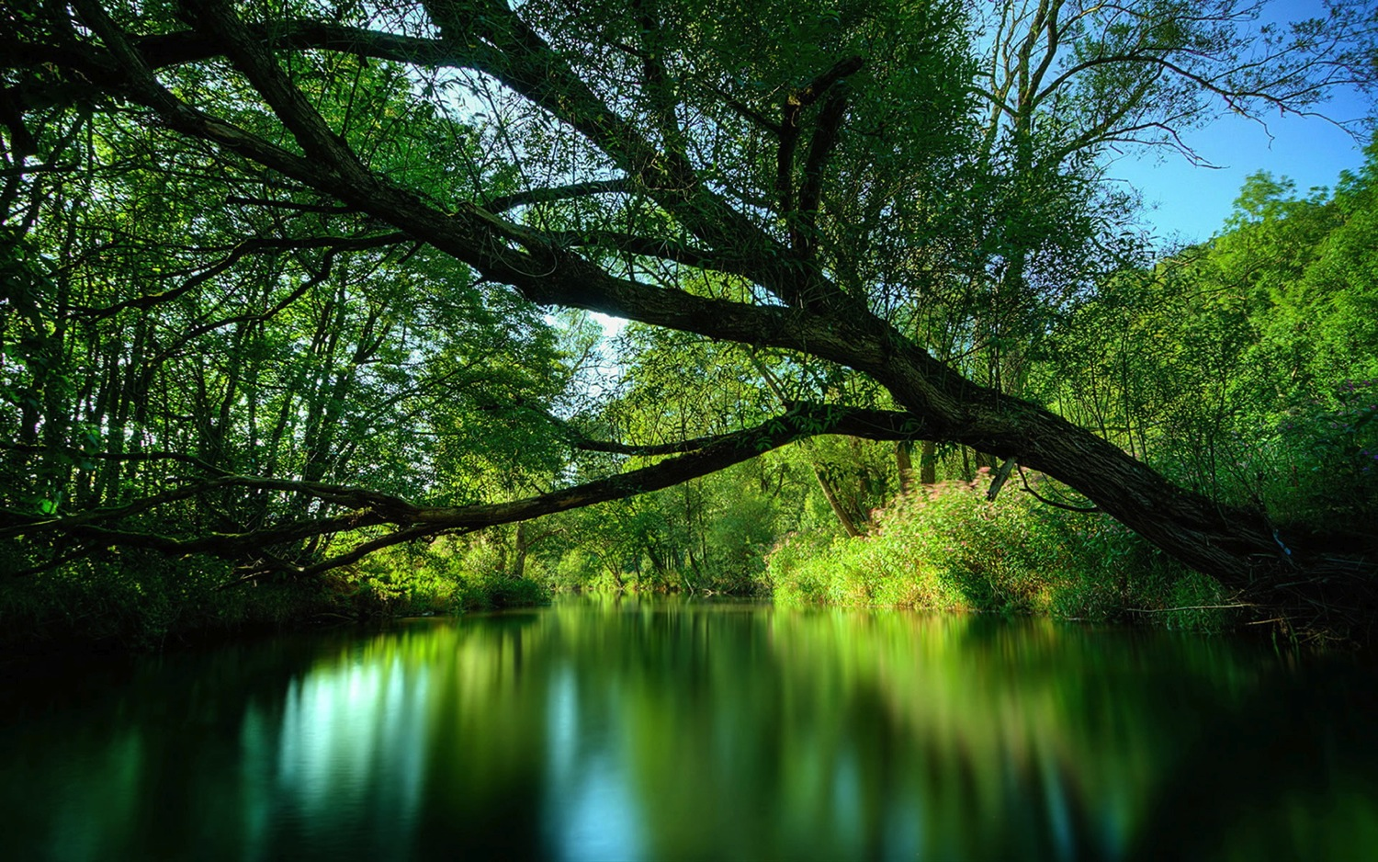
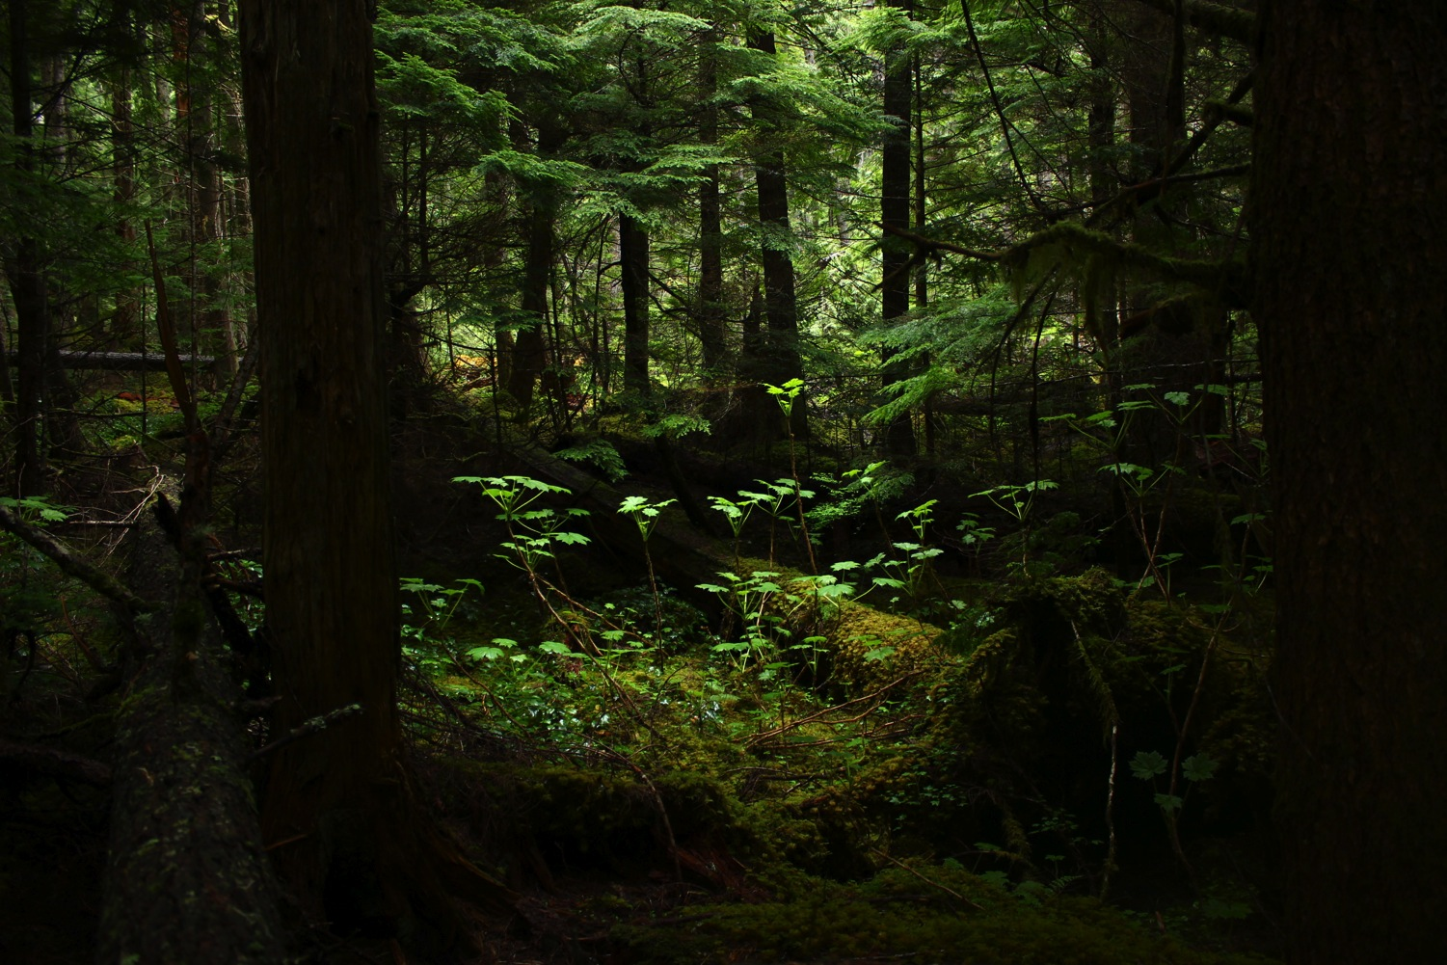
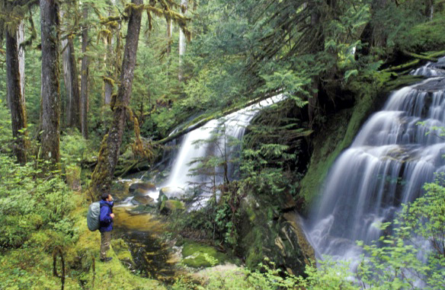
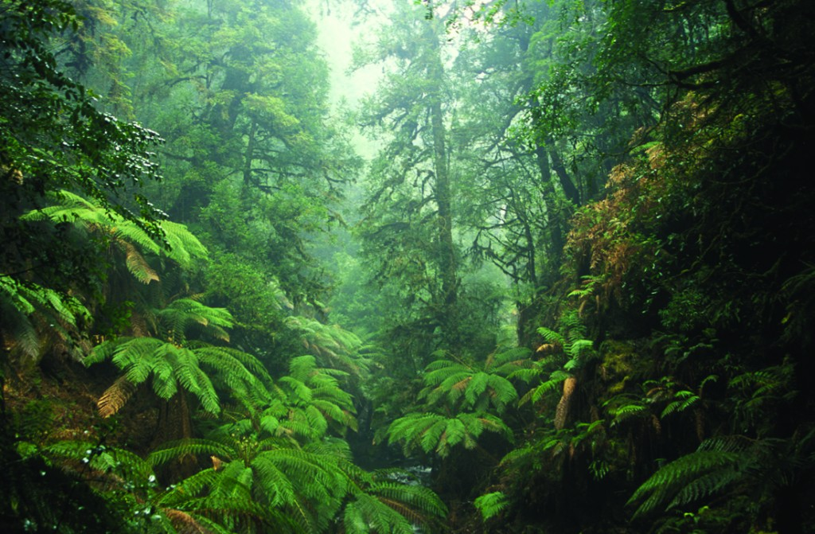
What are rainforests
Rain forests are incredibly beautiful and amazing forests.
Here are some stunning views of a few rainforests.

Slide 3
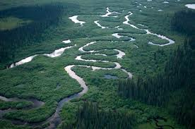
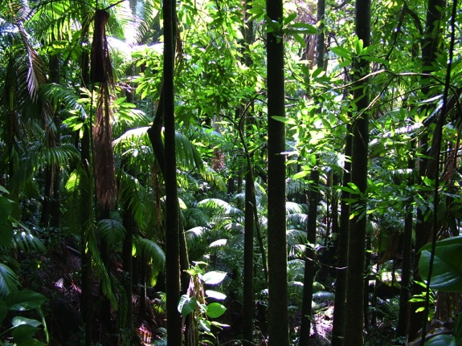
What are rainforests
Rainforests are forests that get a lot of rain.
They are very dense and tall.
The soil in a rain forest is very fertile and so trees and plants grow easily.
The climate in a rainforest is hot, wet and humid.

Slide 4
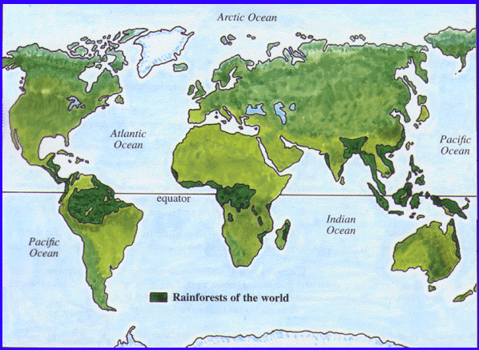
Where are rainforests found
Rain forests are found in Asia, Central America, Amazon, Australasia and Africa.
They are located along the Equator

Slide 5
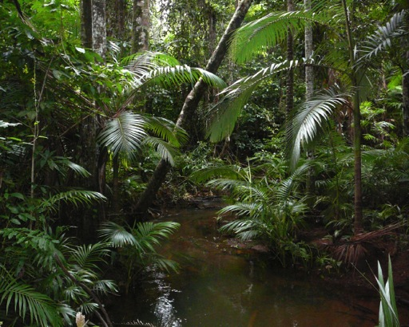
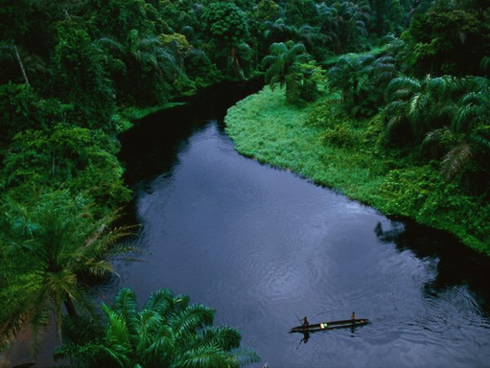
The largest rainforests
The Amazon
is the biggest rainforest in the world. The forest is located in South America with most of the forest running through Brazil.
The Congo
Is found in Central Africa and is the second largest rainforest in the world. There are many different species of animal and plant life here.

Slide 6
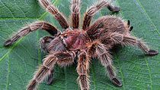
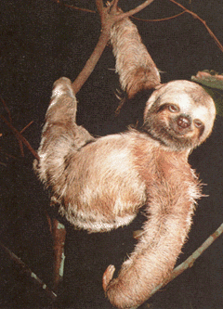
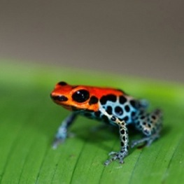
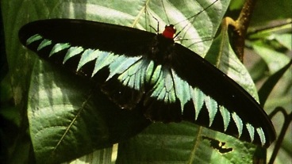
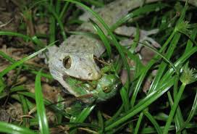
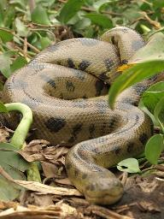
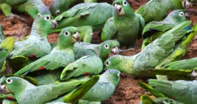
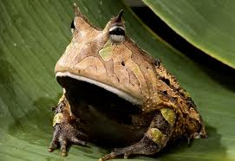
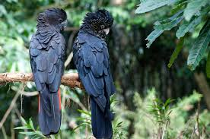
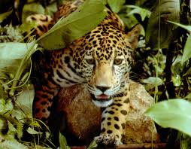
ANIMAL LIFE
Rainforests cover only 6% of the Earth’s surface but they contain more than half of the world’s plant and animal species.
As many as 30 million species of animals live on the tropical rainforests.
Some rainforest monkeys are omnivores, eating both animals and plants.
More than 2,000 different species of butterflies are found in the rainforests of South America.
There are large numbers of birds, animals, insects, amphibians, reptiles, mammals and others that live here.

Slide 7
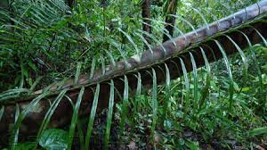
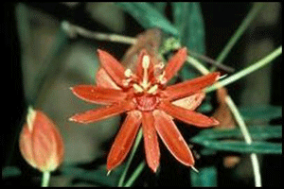
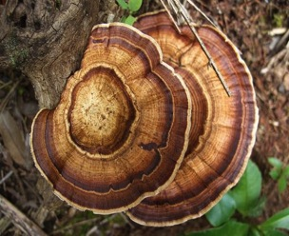
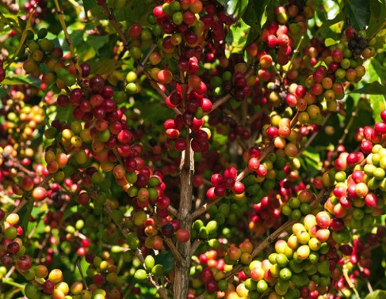
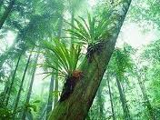
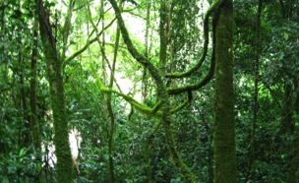
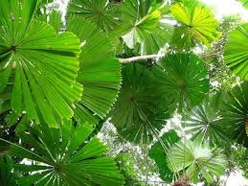
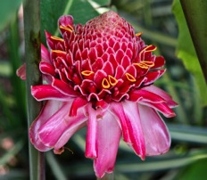
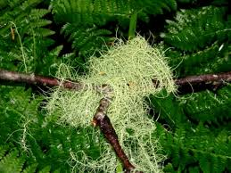
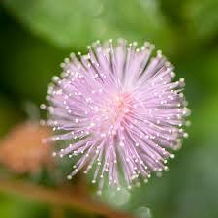
plant LIFE
The forests of Central Africa are home to more than 8,000 different species of plants.
A typical 10km square area contains 1,500 kinds of flowering plants and 750 tree species.
Canopy Trees grow up to 20 to 30 metres tall
Small plants that need more sunlight attach themselves to the trunks and branches of the canopy trees. They never touch the ground, but their aerial roots absorb water from the moist air.

Slide 8
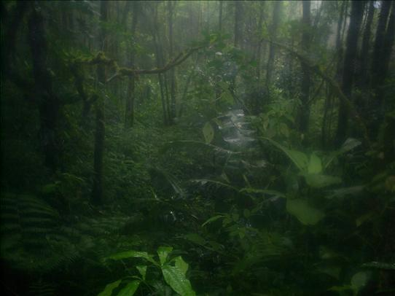
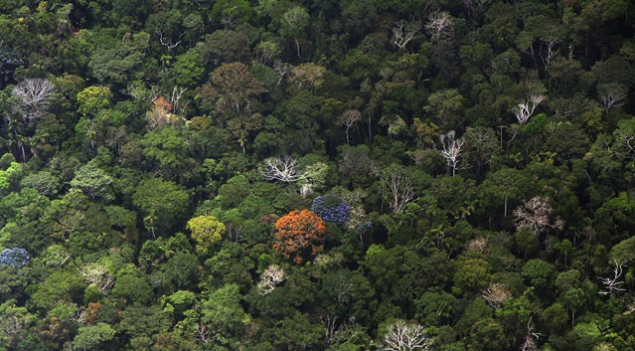
The trees of the rainforests are so dense that they form a large canopy making it very dark underneath with very little sunlight passing through.
Rain falling on the canopy can take as long as 10 minutes to reach the ground.
Sunlight in the forest

Slide 9
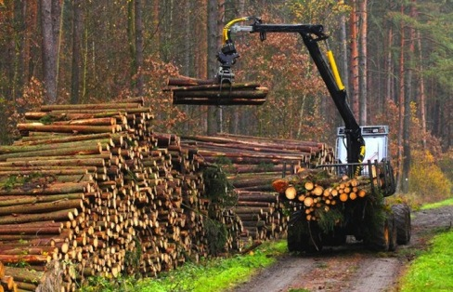
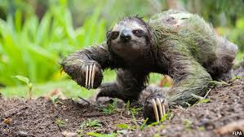
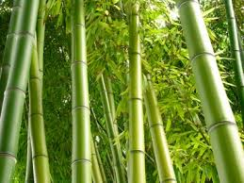
Interesting facts
An area of a rainforest the size of a football field is being destroyed each second.
About 2,000 trees are cut down per minute
In the moist rainforests of South America, sloths move so slowly that algae are able to grow in their fur.
1 out of 4 ingredients in our medicine is from rainforest plants.
Giant bamboo plants can grow up to 9 inches a day.

Slide 10
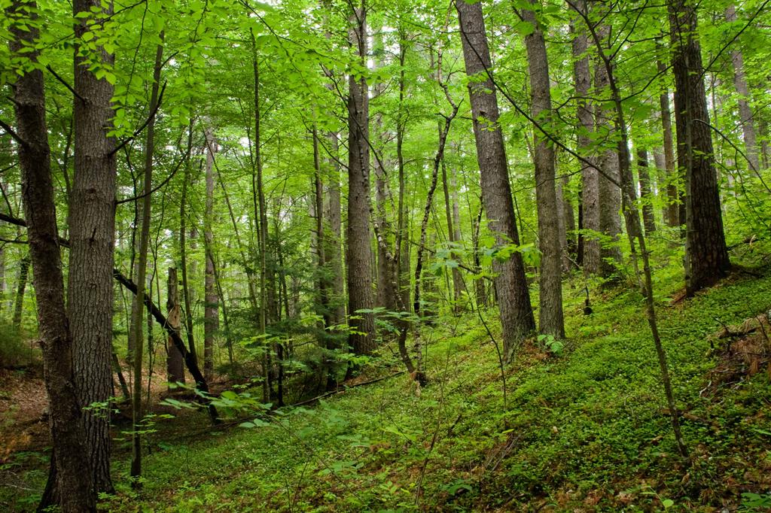
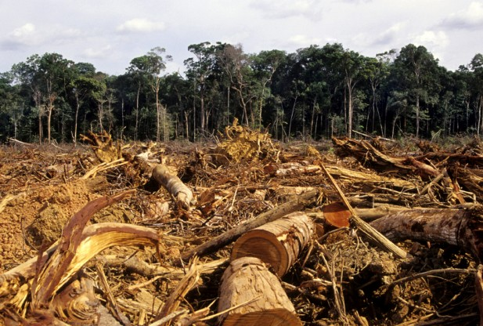
DEFORESTATION
LET’S DO EVERYTHING WE CAN TO SAVE TREES

Slide 11
See you later…

